Slide 1

ECE201R01 : Microprocessor & Microcontroller Unit II: 8086 Addressing Modes

Slide 2
Instruction Format
An instruction specifies:
type of operation,
location of operands
location to store the result of the operation
Location of operands
register name
memory location
immediate data

Slide 3
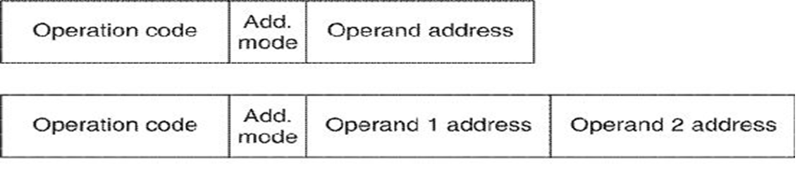
Instruction Format
operand address specifies the location of operand

Slide 4
Instruction Format
Operands located in memory: their addresses may be specified directly or through an indirect way
Addressing Mode bits specify the operand location and how to determine the address of the operand in memory
Simplest type of instruction format contains only the Operation Code but no operand address or addressing mode bits

Slide 5
Addressing Modes
Addressing mode specifies:
Where the operand is located
How to reach the operand location
Operand may be located as:
Immediate data as part of the instruction
Data stored in one of the registers
Data stored in memory

Slide 6
Addressing Modes
Immediate addressing mode: data is specified as part of the instruction
Ex: MOV BX, 97F0H (in Intel 8086)
BX = 97F0H
Register addressing mode: operand is located in one of the registers. Name of the register in coded form may be specified in the operation code
Ex: ADD AX, BX (in Intel 8086)
Operand1 = Data in AX
Operand2 = Data in BX
AX = Operand1 + Operand2
AX = AX + BX
Notes:
BX=97F0H
AX = AX + BX

Slide 7
Addressing Modes
Memory addressing modes: a data byte/word is located in memory. Address needs to be determined to access the data and to perform the specified operation
Address of the operand may be:
specified directly in the instruction:
offset address of the operand is given as a part of instruction
given indirectly in the instruction.
name of the register containing the offset address
of the operand is given as a part of instruction

Slide 8
Addressing Modes
Direct addressing mode: memory operand address (offset) is specified as part of the instruction
Ex: OR AL, [2507H] (in Intel 8086)
Operand1 = Data in AL
Operand2 = Data in PA where, PA = (DS*10H) + 2507H
AL = Operand1 | Operand2
Indirect addressing mode: the instruction specifies a register where the operand address is stored
Ex: SUB AL, [BX] (in Intel 8086)
Operand1 = Data in AL
Operand2 = Data in PA where, PA = (DS*10H) + BX
AL = Operand1 - Operand2
Notes:
AL = AL – [BX]
PA = (DS*10H)+BX = 20004H
MOV AX,[BX]

Slide 9
Addressing Modes
BASED INDIRECT: BX / BP – BASED
INDEXED INDIRECT: SI / DI – INDEXED
Based Indexed addressing mode: useful when different elements of a list or an array are to be accessed in loop for performing the same set of operations
Base of the array is specified in a register called Base register.
The index or distance of the element from the base of the array to be accessed is specified in a register called Index register.
MOV [BX + DI], AL (in Intel 8086) :
EA = [BASED] + [INDEX]
((DS*10H) + (BX) + (DI)) (AL)
Notes:
BASED INDIRECT: BX / BP – BASED
INDEXED INDIRECT: SI / DI – INDEXED
BASED + INDEXED: EA = [BASED] + [INDEX]

Slide 10
Addressing Modes
BASE + RELATIVE : MOV [BX+09],DL
INDEX + RELATIVE : ADD AL,[SI+78H]
Base plus Index plus Relative Addressing mode: useful in case of two-dimensional arrays
Base register contains the base address of the array.
Index register contains the increment from base to the row where the data is stored.
Displacement mentioned in the instruction (immediate) or in a separate register is the displacement of the element from the start of the row.
MOV (BX + DI + 4), CL (in Intel 8086):
EA = [BASE] + [INDEX] + RELATIVE
((DS)*10H + (BX) + (DI) + 4) (CL)
Notes:
EA = [BASE] + [INDEX] + RELATIVE
BASE + RELATIVE : MOV [BX+09],DL
INDEX + RELATIVE : ADD AL,[SI+78H]

Slide 11
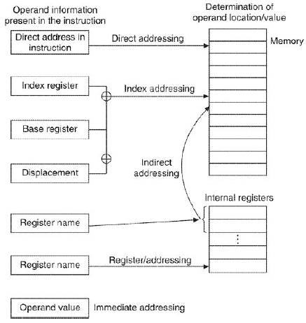
Addressing Modes
Notes:
MOV AL, [BX+05] : AL = ((DS*10H)+BX+05) ; MEMORY READ
MOV [BX+05], AL : ((DS*10H)+BX+05) = AL; MEMORY WRITE
MOV AL, [SI+05] : AL = ((DS*10H)+SI+05)
MOV AL, [BX+SI+05] : : AL = ((DS*10H)+BX+SI+05)

Slide 12
Thank you . . .

